Slide 1
Universitatea din București
Facultatea de Matematică și Informatică
Specializarea Informatică
Heart Failure Prediction
using Azure ML SDK
Iordachescu Anca-Mihaela

Slide 2
Development Process
Choose a right dataset in order to resolve the task that consists in predicting if a person has a high risk of heart failure and preparing the dataset for training and testing.
Choosing the best approach using AutoML by running an Automated Machine Learning Experiment to determine the most effective algorithm and preprocessing option.
Deploy the model as a Web Service and consume it from a client application.

Slide 3
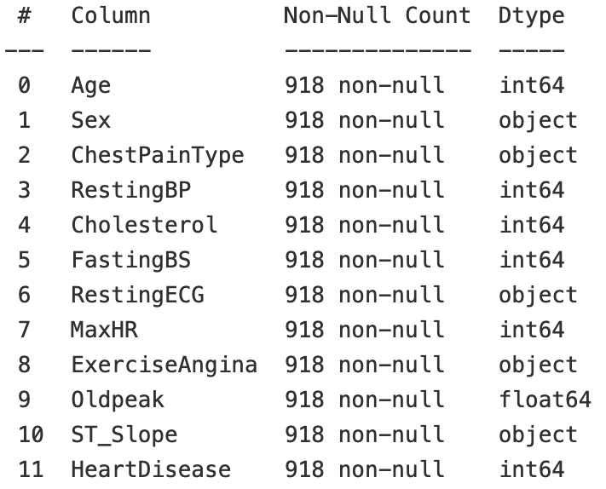
Dataset
Heart Failure Prediction Dataset [1] consists of five datasets that have 11 features regarding heart failure and is the largest heart disease dataset available so far for research purposes.
It is used for binary classification problems.
918 observations.
No duplicates, no null values.
Preprocessed the 5 text column by using One Hot Encoder.
Final total variables number - 20.
Splitting the dataset: 80% training and 20% testing.

Slide 4
AutoML training settings [2]
iterations_timeout_minutes | 10 | Time limit in minutes for each iteration.
experiment_timeout_hours | 0.25 | Maximum amount of time written in hours before the experiment terminates.
enable_early_stopping | True | Enable early termination
primary_metric | Accuracy | Metric to optimize based on the machine learning task
n_cross_validation | 5 | Number of cross-validation splits

Slide 5
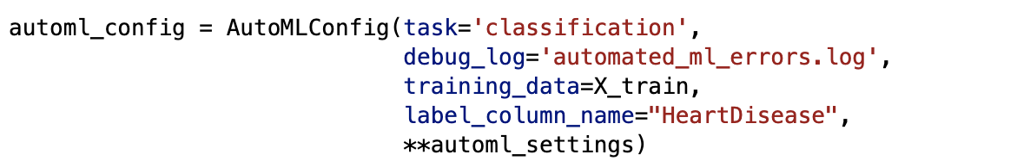
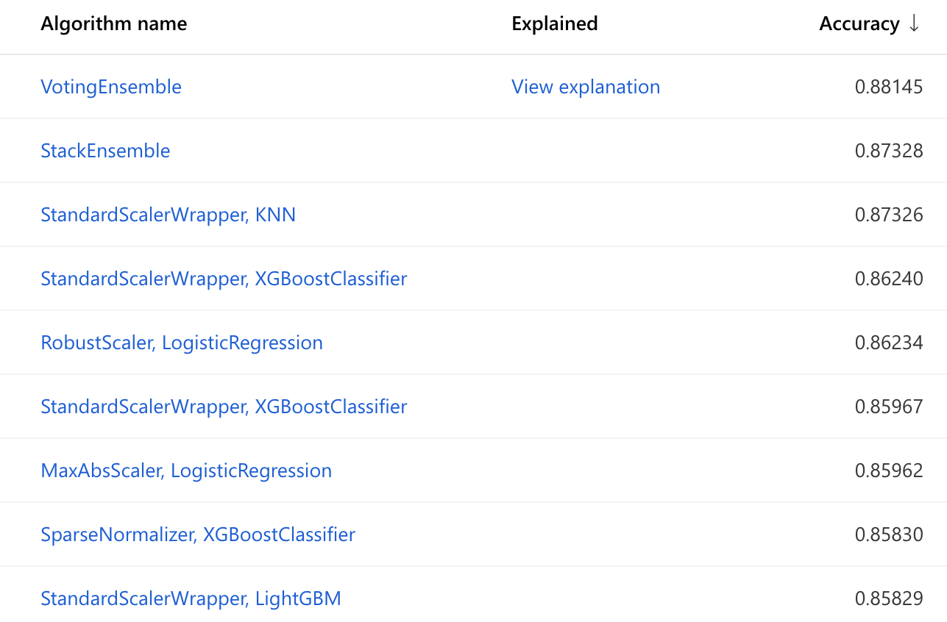
Configuration of the automated machine learning experiment
The best Machine Learning approaches using AutoML

Slide 6
Results
The best model was obtained by using Voting Ensemble on the best ML approaches.
Accuracy obtained on Cross-Validation: 88.1 %.
Accuracy obtained on testing data: 88.0 %.
Retrieve the best model and register the trained model into a pickle file.

Slide 7
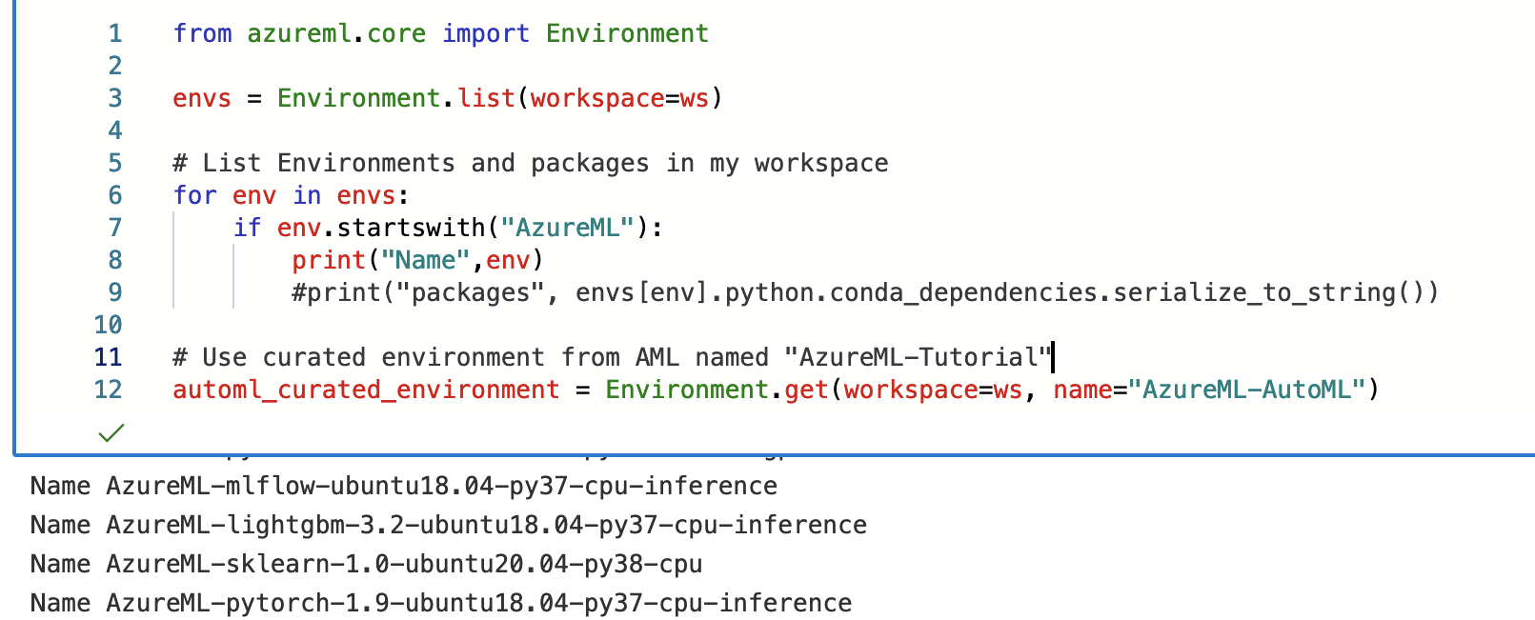
Deploying the model
Creating a web service to host the model requires the following:
Entry script : A Python file that contains code to get the trained model, to load input data and to generate the predictions.
Configuration files : any required Python dependencies to initialize.

Slide 8
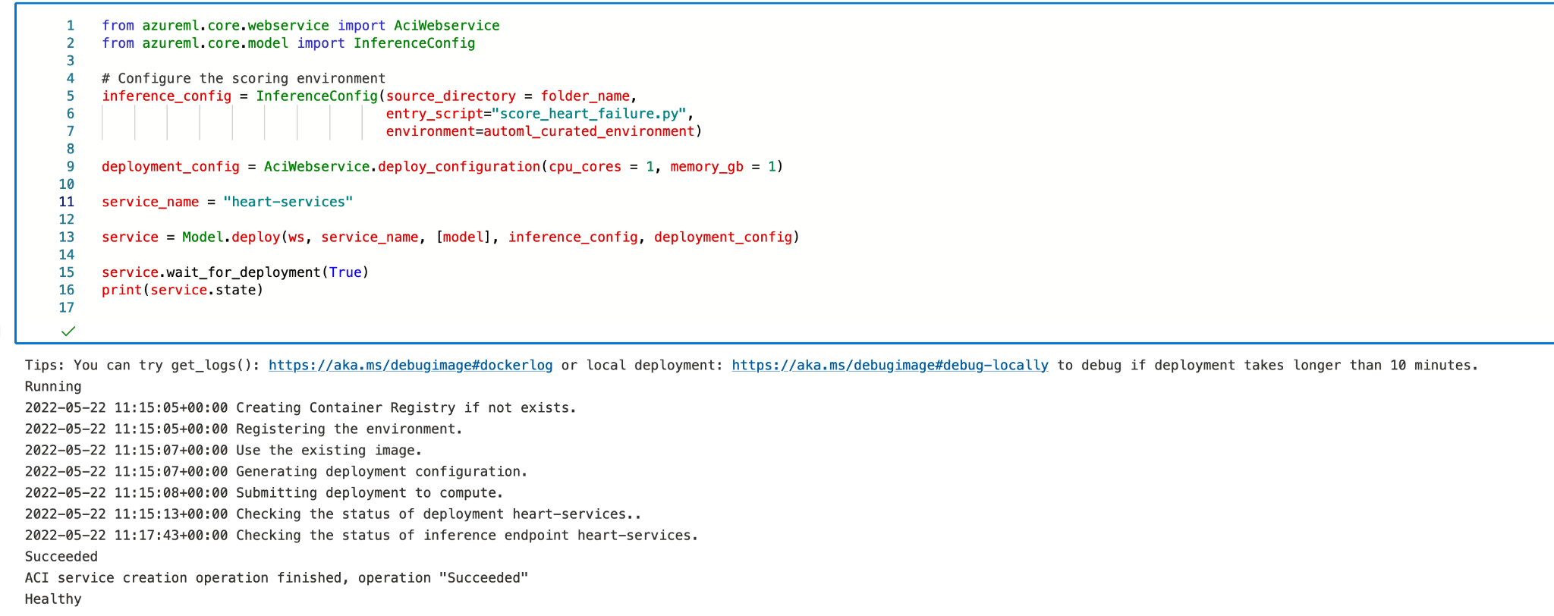
Deploying the
heart-services container
inference configuration (the entry script and the configuration files).
deployment configuration.
Deploy the trained model.
Check the status of the deployed services: Healthy.

Slide 9
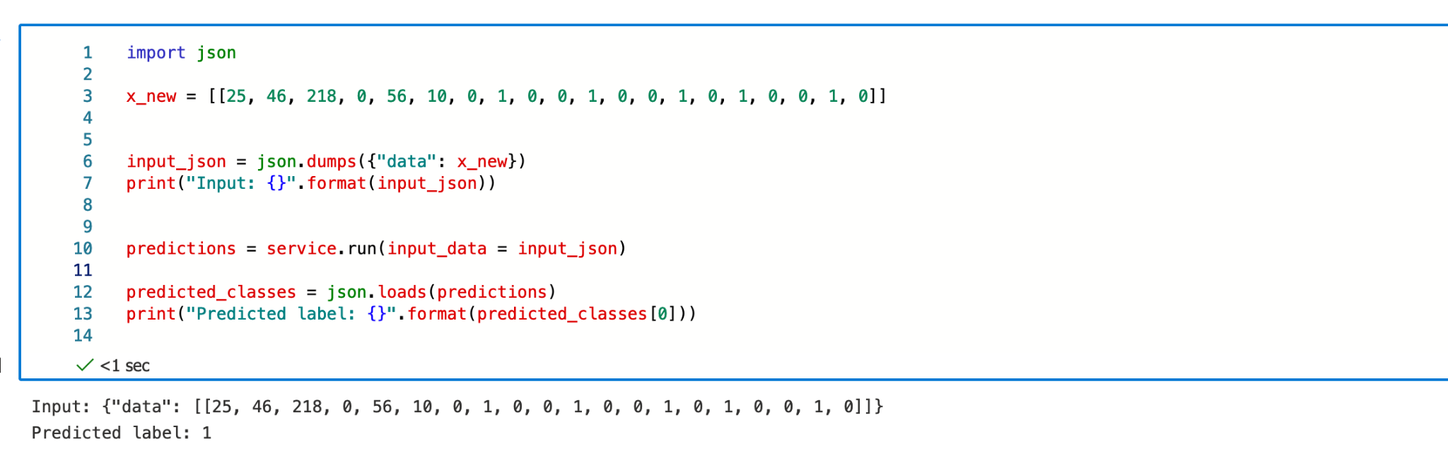
Using the Web Service

Slide 10
DEMO
CONSUMING THE SERVICE USING POSTMAN

Slide 11
References
https://www.kaggle.com/datasets/fedesoriano/heart-failure-prediction
https://docs.microsoft.com/en-us/azure/machine-learning/tutorial-auto-train-models

